Slide 1
Web Service on the Fly
Dario Camol – Gino Mascotti
ISTAT - Italian National Institute of Statistics
Division of Users’ Needs, Integration and Territory

Slide 2
Web service on the fly
The project foresees the development of a set of web services (.NET) to disseminate data and structural metadata through the SDMX standard 2.0/2.1
The SDMX approach will be a «dissemination» one. The Structural medatada will be created at RUNTIME (On the Fly) from Stat’s dataset structure.
The application will use the libraries developed by the European Commission: CommonAPI

Slide 3
Web service on the fly - Features
The web service will be able to manage Time Series data collection. It will provide the output of the following SDMX Messages
2.0
Compact data message
Generic data message
Registry response structural message / structure message
2.1
Generic Time Series data message
Structure Specific Time Series data message
Structure messages

Slide 4
Web service on the fly – Features – Structural metadata
Streaming
Time Stamp
Use of the Common API
2.0/2.1 Error standardization
It can return the following structural metadata (through the QueryStructure web method):
Dataflows
Category scheme
Organization scheme (Agency scheme)
Concept scheme
Codelist
Data Structure Definition

Slide 5
Web service on the fly – Features – Structural metadata
Object | From…
Dataflows | Stored procedure: proc_WBS_GetDatasetList
Category scheme | QueryManager DB select from [QueryManager].[dbo].[ContentTree]
Concept scheme | Stored procedure: proc_WBS_GetDatasetDimensionsList Attribute list : interface implementation OBS_STATUS = FLAG (configurable)
Organization scheme | From the application config file (agency)
Codelist | Stored procedure: proc_WBS_GetDimensionMembersListFiltered
Data Structure Definition
Dimension | Stored procedure: proc_WBS_GetDatasetDimensionsList
Attributes | Attribute list : interface implementation OBS_STATUS = FLAG (configurable) proc_WBS_GetDatasetFlags
Roles | TimeDimension: proc_WBS_GetDatasetDimensionsList Frequency Dimension: fixed FREQ or FREQUENCY (output FREQ mandatory) TimeFormat: interface implementation
Data | Stored Procedure: proc_SDMX_GetObservations

Slide 6
Web service on the fly – Features – Scalability/Reusability
A big effort has been necessary to design an application that can be scalable and reusable.
Design pattern
Use of interface that can be implementend on the base of the specific data access
Use of the CommonAPI (version agnostic)
IBaseManager
Select * from….
IAttributesManager
<Codelist><Code value="P1D">
<Name LocaleIsoCode="en"><![CDATA[Daily]]></Name><Name LocaleIsoCode="fr"><![CDATA[Daily]]></Name>
IDimensionManager
SDMXObjects
IConceptManager
ICategoryManager
EXEC proc_SDMX_GetObservation….
IDataflowManager

Slide 7
Web service on the fly – Features – Attributes
IBaseManager
IAttributesManager
AttributeManager
IDimensionManager
XML File
<Attribute Code="TIME_FORMAT" attachmentLevel="Observation" assignmentStatus="Conditional" isTimeFormat="true" >
<Name LocaleIsoCode="en"><![CDATA[TIME_FORMAT AVAILABILITY]]></Name>
<Name LocaleIsoCode="fr"><![CDATA[TIME_FORMAT AVAILABILITY]]></Name>
<Codelist>
<Code value="P1D">
<Name LocaleIsoCode="en"><![CDATA[Daily]]></Name>
<Name LocaleIsoCode="fr"><![CDATA[Daily]]></Name>
….
IConceptManager
ICategoryManager
IDataflowManager
The current implementation of the AttributeManager provides the reading of an XML where are stored
all the information releted to additional attributes:
Name, Attachment level, Assigment Status, roles, codelist
These information are used during the creation of the Data Structure Definition and the data message.
If the attributes defined into the XML file are present into the result of the Data store procedure they will be disseminated into the data message.

Slide 8
Web service on the fly – Features – Attributes – OBS_STATUS
In the current implementation of .Stat manages the FLAG attributes.
It can be assumed as an OBS_STATUS attribute.
<add key="ConceptObservationFlag" value="OBS_STATUS" attachmentLevel="Observation" assignmentStatus="Mandatory">
<Name LocaleIsoCode="en"><![CDATA[Observation status]]></Name>
<Name LocaleIsoCode="fr"><![CDATA[Observation status]]></Name>
</add>
The codelist of this attribute can be retrieved through the stored procedure:
proc_WBS_GetDatasetFlags
The data are retrieved using the stored procedure:
proc_SDMX_GetObservations
in the FLAG field.

Slide 9
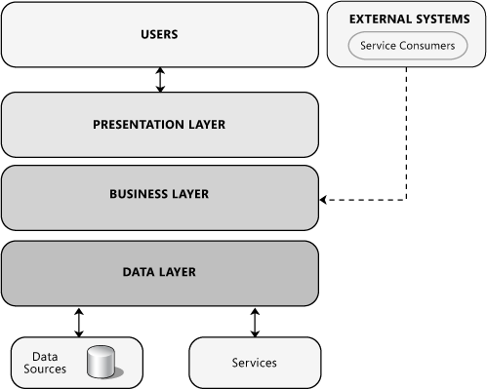
Design pattern - Layering
Presentation layer
The user can access to the application through three end points
WS_REST_SDMX 2.0/2.1
WS_SOAP_SDMX 2.0
WS_SOAP_SDMX 2.1
Business layer
This layer is the core of the application and provides data to the upper layer
FlyController
FlyEngine
Persistence layer - DAL
This is the persistence layer. It is aimed to get the data from the database
FlyMapping

Slide 10

Design pattern - Layering
FlyEngine
FlyMapping
WS_SOAP_20
WS_SOAP_21
WS_REST_2.0/2.1
FlyController
DDB
VIEW
BUSINESS
MODEL-DAL

Slide 11
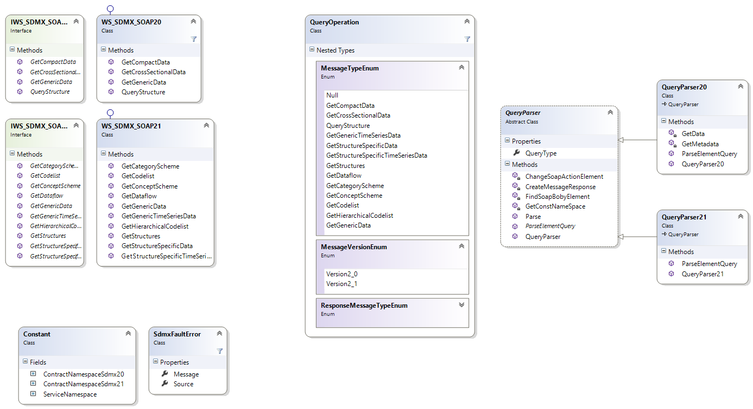
Design pattern – Layering - View
Soap Response
Query Soap
Sdmx 2.0
Query Soap
Sdmx 2.1
In case of error return soap Sdmx Standard Error

Slide 12
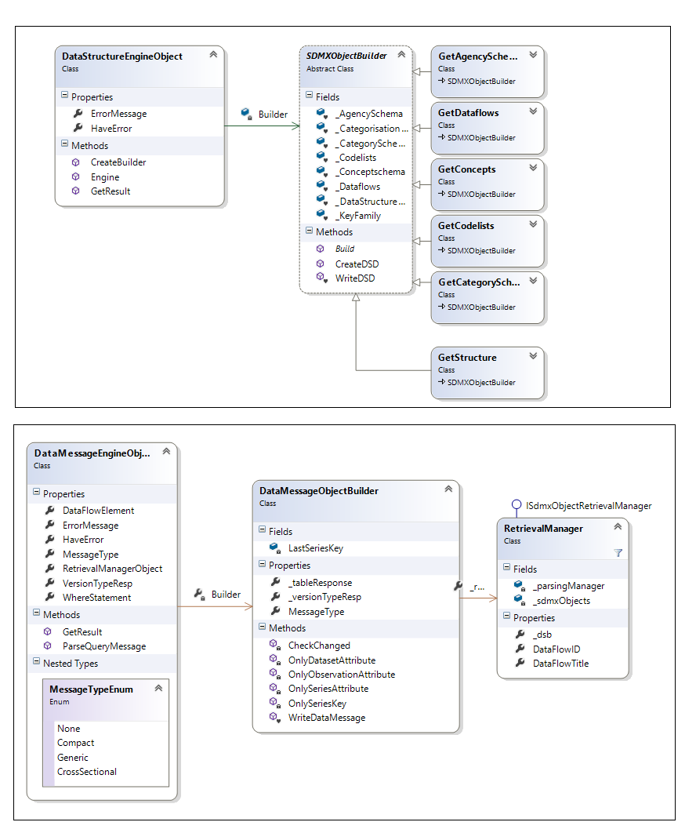
Design pattern – Layering – Business – Fly Engine
This Functions calls
related flyMapping
functions
and builds
a SDMXObject
Metadata
This Function calls
Metadata GetStructure,
builds a RetrievalManager
using DataMessageEngine
in FlyMapping and builds
a correct formatted response
Data

Slide 13
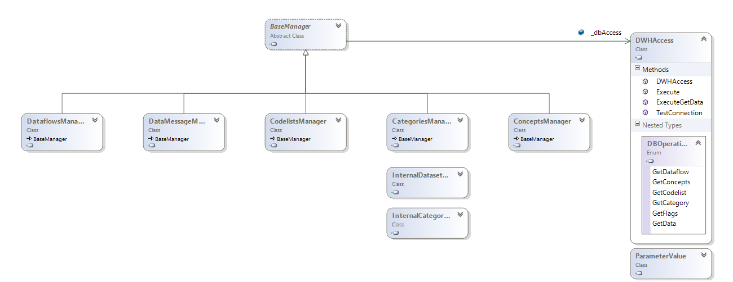
Design pattern – Layering – DAL – Fly mapping
Persistence layer: this layer calls the specific StoreProcedure
in the datawarehouse and returns the object for the creation
of the datamessage or the structural medatata message
Special case for Category and Categorysation, in this case is not called a storeprocedure but queries a QueryManager DB and return a custom object for creation of sdmxObject

Slide 14
This release
This release - 07/07/2014

Slide 15
Already implemented 07/07/2014
Two SOAP endpoints:
Soap 2.0
GetGenericData
GetCompactData
QueryStructure
Soap 2.1
GetGenericTimeSeriesData
GetStructureSpecificTimeSeriesData
QueryStructure
Structural metadata downloadable through the QueryStructure web method:
Organization scheme
Category scheme
Dataflows
Concept scheme
Codelist
Data Structure Definition
Soap SDMX 2.1 errors (the standard is used also in the 2.0 version)

Slide 16
To be implemented
One Rest endpoint
Rest 2.0
Rest 2.1
The rest implementation will use the 2.1 standard
Complex query 2.1
Streaming
TimeStamp
Log management

